Slide 1
LIDAR and Photogrammetry

Slide 2
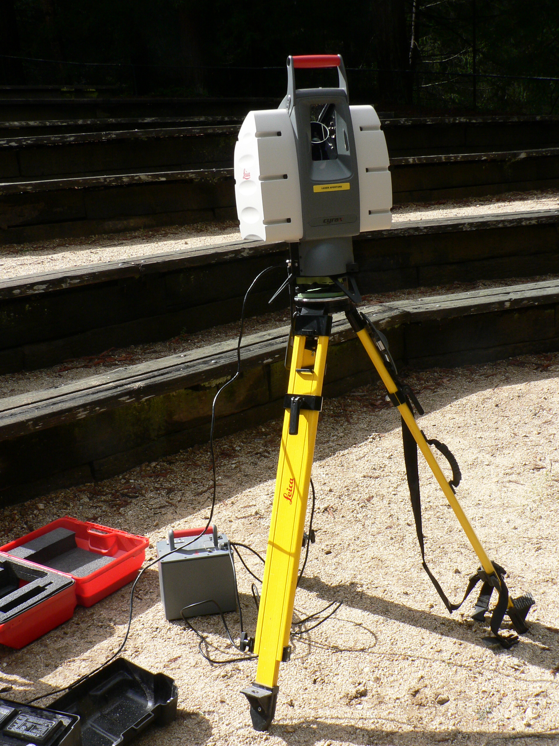
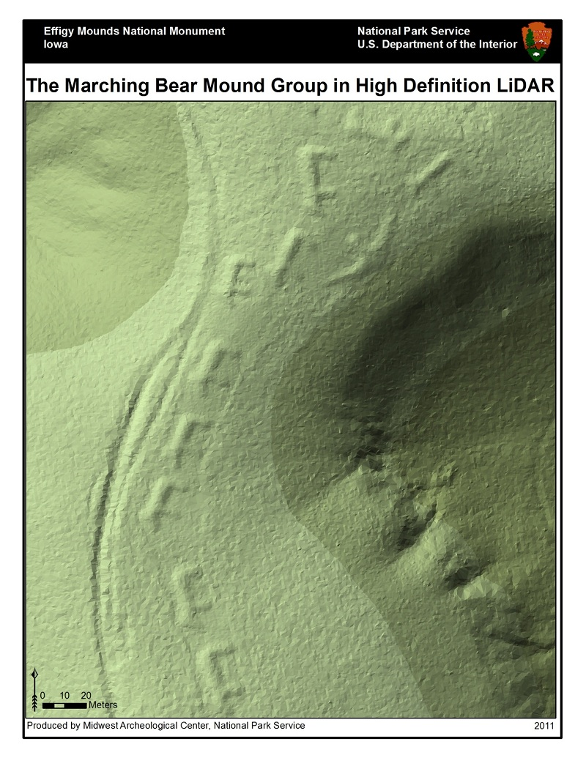
LiDAR and Photogrammetry
Two different techniques for getting similar or the same information: precise locations in 2D or 3D space
LiDAR – dense 3D point clouds that are precisely located in 3D space
By David Monniaux - Own work, CC BY-SA 3.0, https://commons.wikimedia.org/w/index.php?curid=1730946

Slide 3
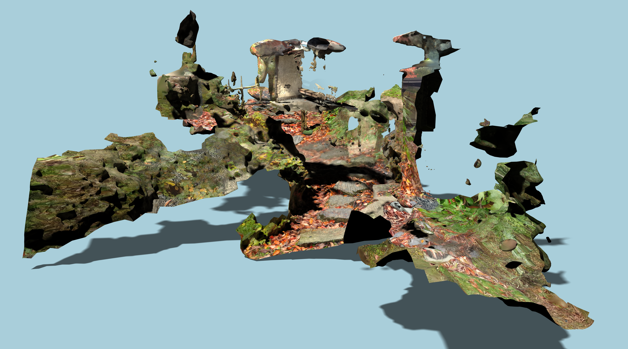
LiDAR and Photogrammetry
Two different techniques for getting similar or the same information: precise locations in 2D or 3D space
Photogrammetry – depends on processing workflow, can either be georeferenced images or 3D point clouds
By Tuure Leppänen - https://doi.org/10.5281/zenodo.6034706, CC BY 4.0, https://commons.wikimedia.org/w/index.php?curid=115309249

Slide 4
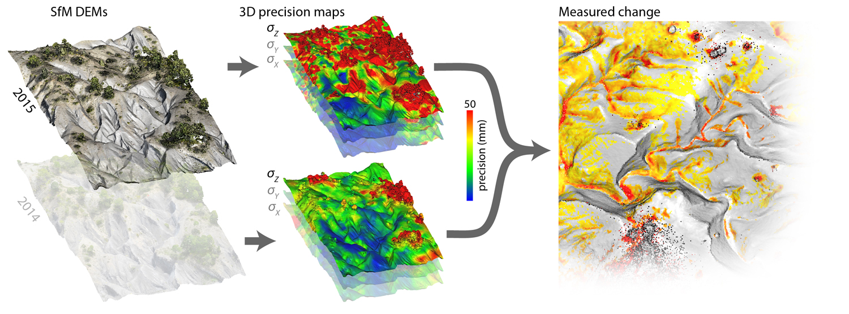
LiDAR and Photogrammetry
Two different techniques for getting similar or the same information: precise locations in 2D or 3D space
3D point clouds from both can be used to derive higher-order products e.g. change detection
https://www.lancaster.ac.uk/staff/jamesm/software/sfm_georef.htm

Slide 5
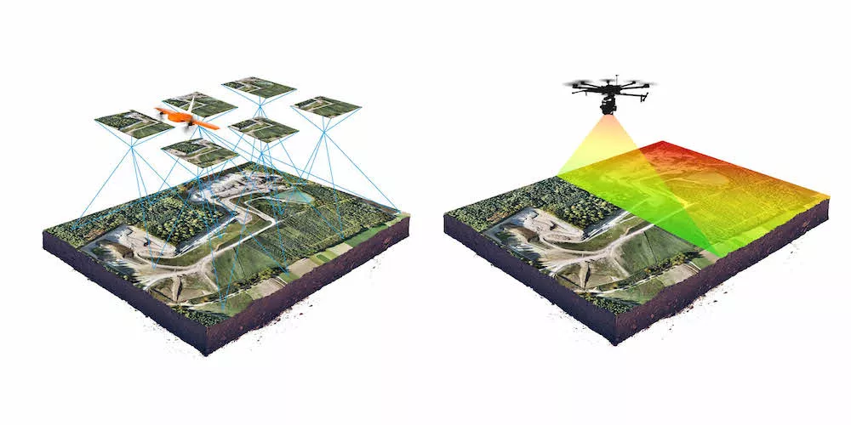
LiDAR and Photogrammetry
Two different techniques for getting similar or the same information: precise locations in 2D or 3D space
Different limitations and advantages to each method
https://wingtra.com/drone-photogrammetry-vs-lidar/

Slide 6
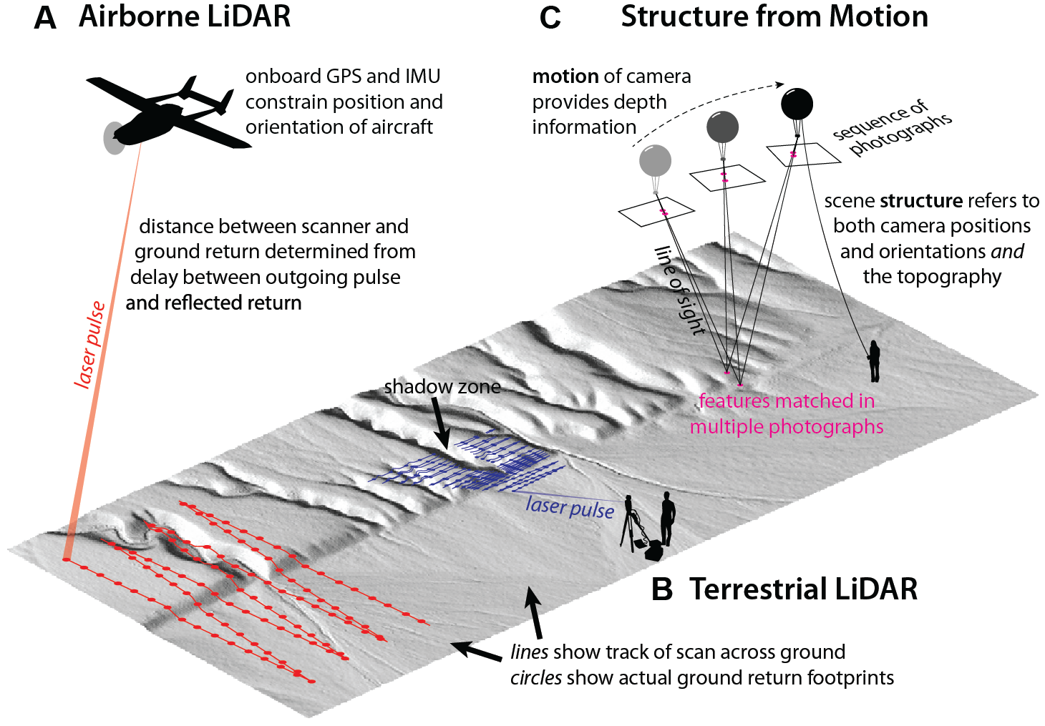
What can we compare sfm to?
Figure Johnson 2014
Notes:
Structure-from-Motion is not the only way to create a georeferenced point cloud like the one on the previous slide. The other option is using something called LiDAR. LiDAR laser scans an area of interest to create a 3D point cloud. Two example platforms for LiDAR are shown. You can fly a plane over an area at an altitude of roughly 1 km to get a point cloud or have a scanner on a tripod as shown in B. LiDAR can be used with many other platforms not seen here. Typically, LiDAR is how scientists are able to collect 3D point clouds for research. We will see some direct comparisons between LiDAR and SfM in later slides. (Kendra Johnson, Geosphere 2014)
Note: GSA Publications allow the reproduction of a single figure or table under without permissions. http://www.geosociety.org/pubs/copyrt.htm

Slide 7
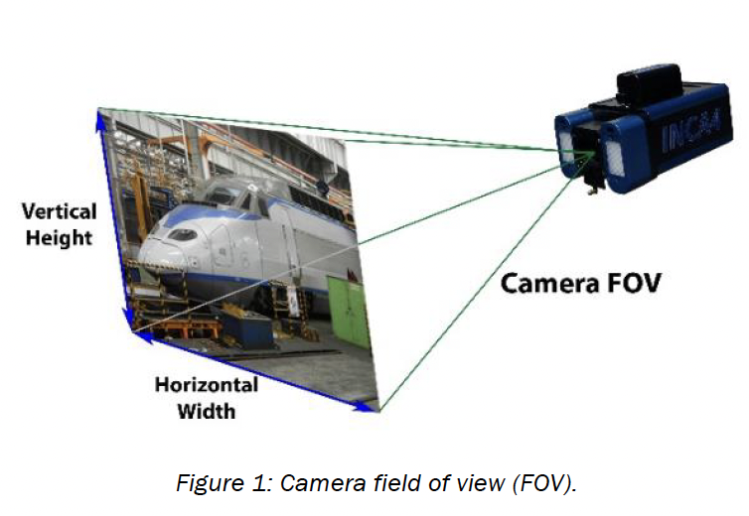
Photogrammetry
Photogrammetry is a process for extracting three-dimensional maps and models from photographs.
The fundamental principle used by photogrammetry is triangulation. By taking photographs from at least two different locations, so-called "lines of sight" can be developed from each camera to points on the object.

Slide 8
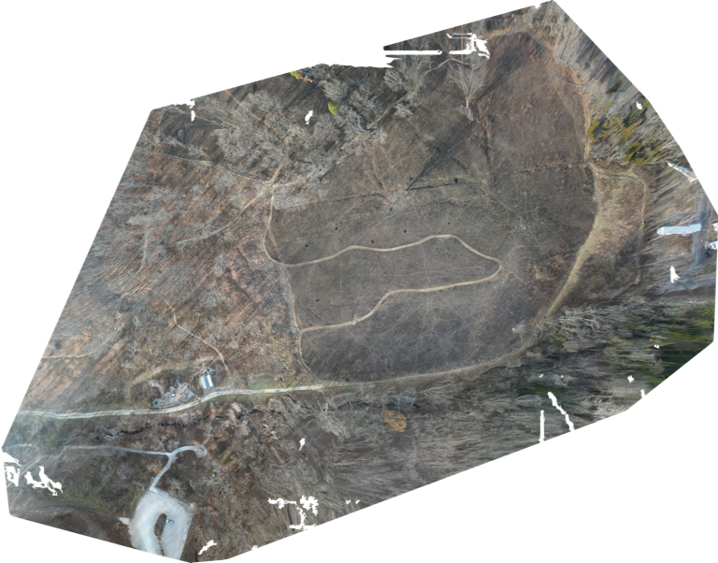
Photogrammetry
By combining measurements taken from multiple lines of sight, accurate positions in 2D and 3D information can be reconstructed
Examples:
Orthomosaic (georeferenced) images
3D point clouds
(akin to what is produced by lidar)

Slide 9
Orthomosaic
An orthophoto is an aerial image that’s geometrically corrected to produce a uniform perspective and scale, so it can be used to measure true differences.
To produce a uniform scale, the image needs to be corrected for factors including camera tilt, lens distortion, and environmental conditions.

Slide 10
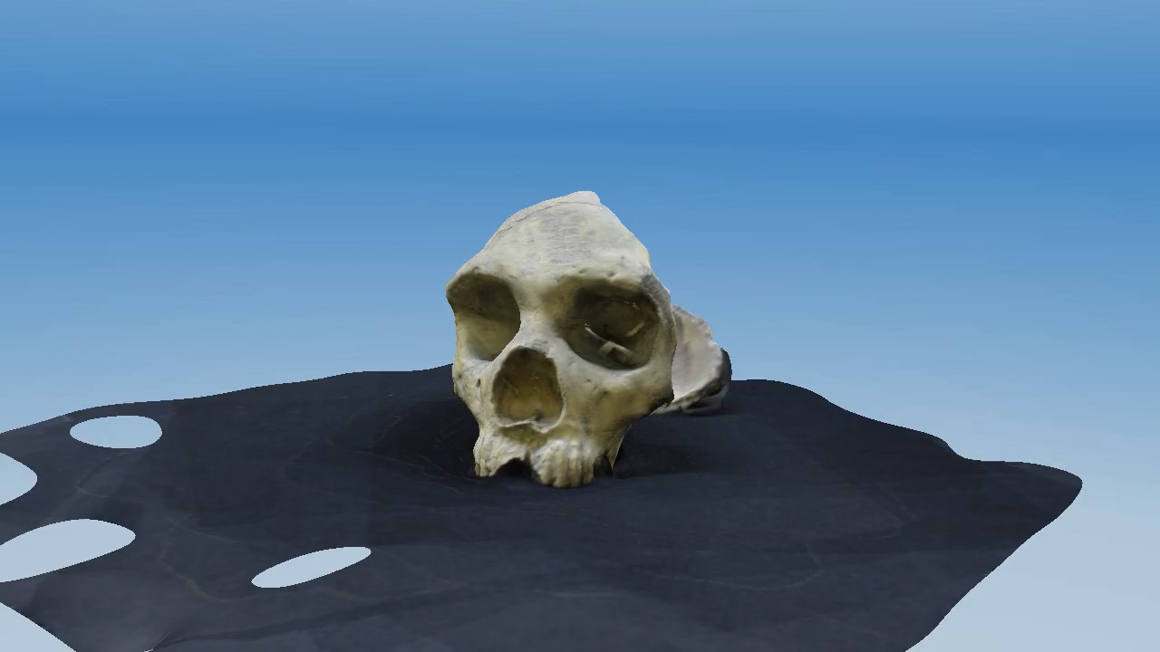
Structure-from-Motion
Structure from Motion is a technique that calibrates two-dimensional images into a reconstruction of a three-dimensional structure, scene, or object.

Slide 11
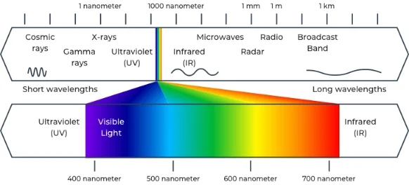
Types of photogrammetric images
Thermal (IR), optical, and multispectral (several bands) most common for photogrammetry and have multiple applications

Slide 12
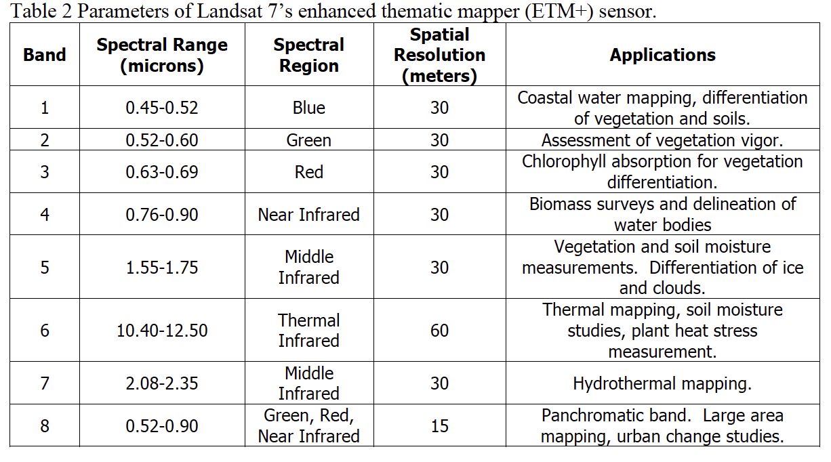
Types of photogrammetric images
Both on-the-ground (camera in hand), near-surface (UAV) and remotely-sensed (satellite) images can be used

Slide 13
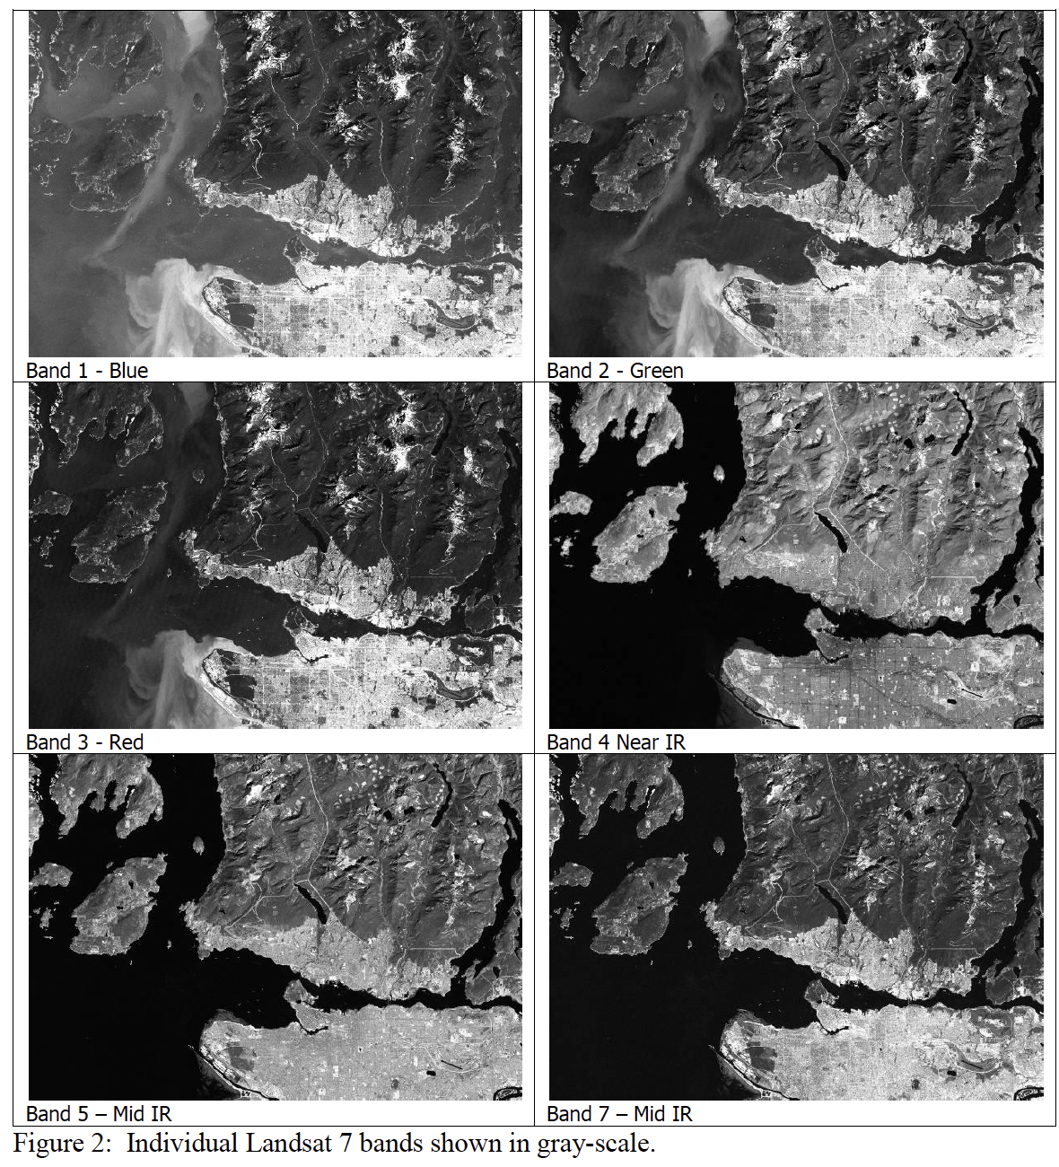
Types of photogrammetric images
Example LandSat bands

Slide 14
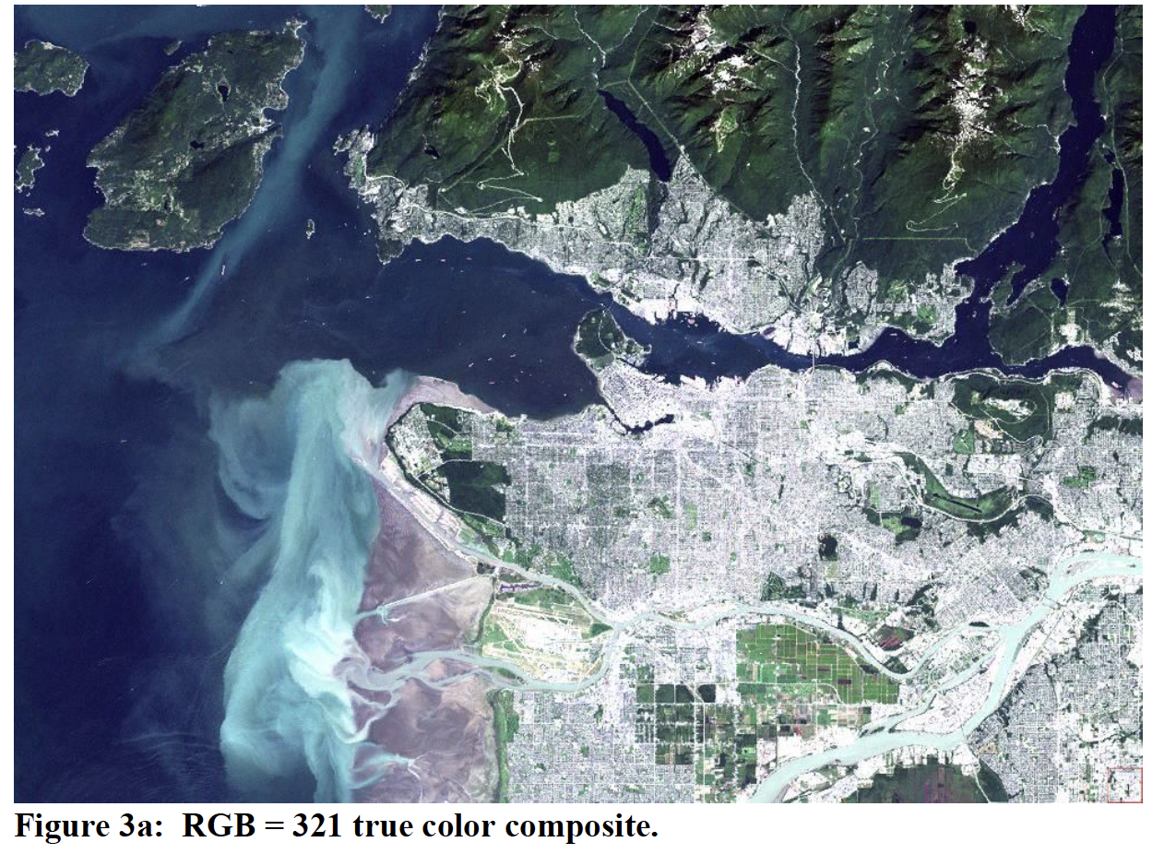
Types of Photogrammetric Images

Slide 15
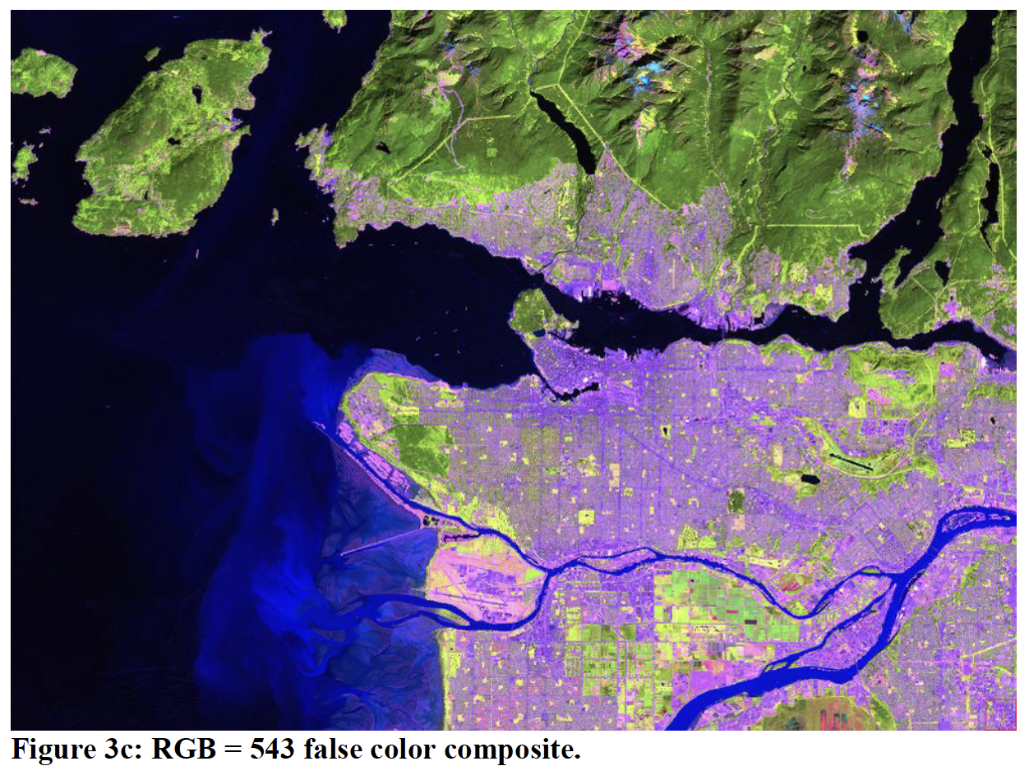
Types of Photogrammetric Images

Slide 16
Types of Photogrammetric Images
Note: photogrammetry describes the process of orthorectifying / georeferencing the images not the specific band content

Slide 17
So how does it work?

Slide 18
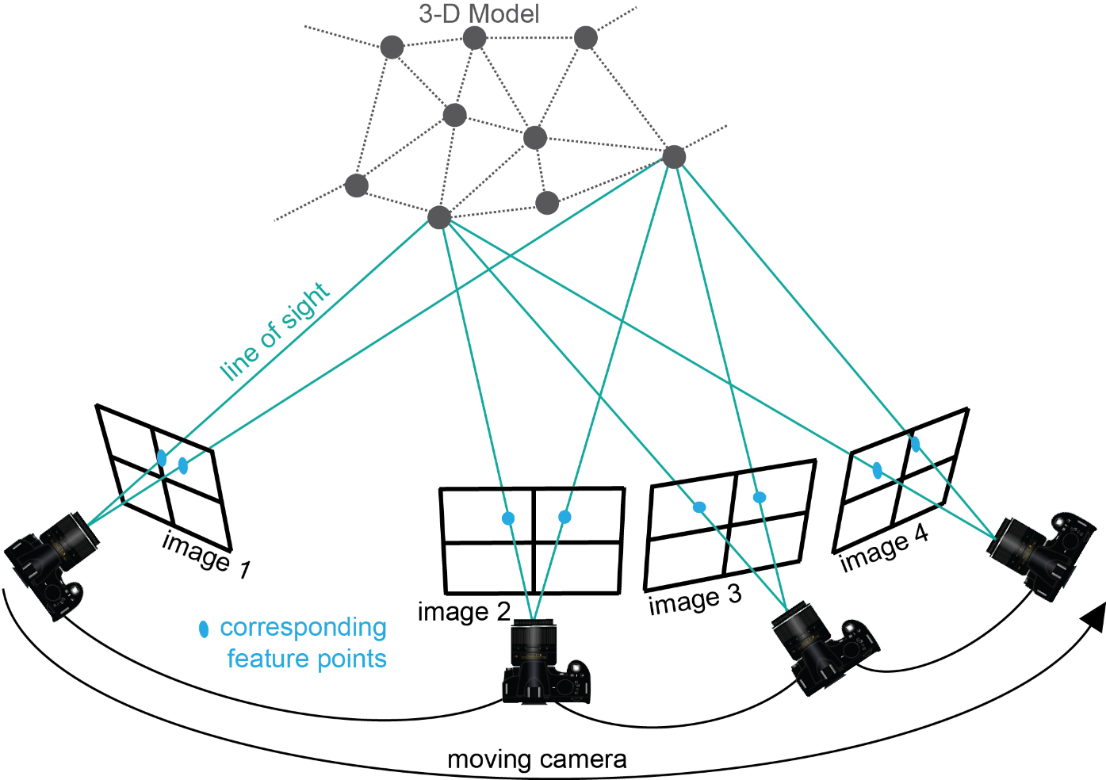
Structure-from-motion?
Use the locations of the camera (motion) to interpret the geometry or 3D model (structure) of a scene
Figure Kate Shervais
Notes:
Structure-from-Motion photogrammetry is an emerging technique used to create three-dimensional point clouds with associated color—basically a three-dimensional model of the area of interest. The key things to notice here are that the camera needs to continually be moving (no two photos taken from the same location) and the photographs need to include the same features, so that features are in multiple photographs. You can see here that many of the gray dots on the 3D model are captured by multiple images, not just one. Scientists use this for many applications, which you will learn about today. The next slide will show what Structure-from-Motion actually produces.

Slide 19

Matching features
d
Step 1
Match corresponding features and measure distances between them on the camera image plane d, d’
The Scale-Invariant Feature Transform is key to matching corresponding features despite varying distances
d'
Figure Ed Nissen
Notes:
The first step in actually creating the product we saw on the previous slide is to find the same feature in multiple photographs. You can see [spacebar] the red and purple lines tracing the line of sight from the two camera locations to two different features on the ground. This is done using an algorithm called SIFT: Scale-Invariant Feature Transform.

Slide 20
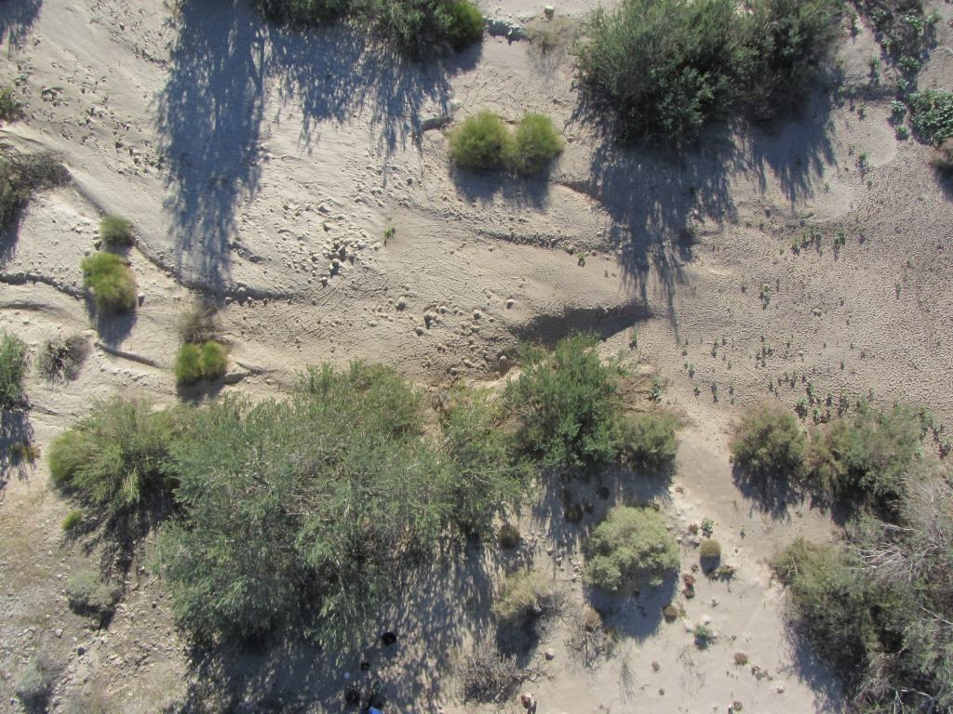
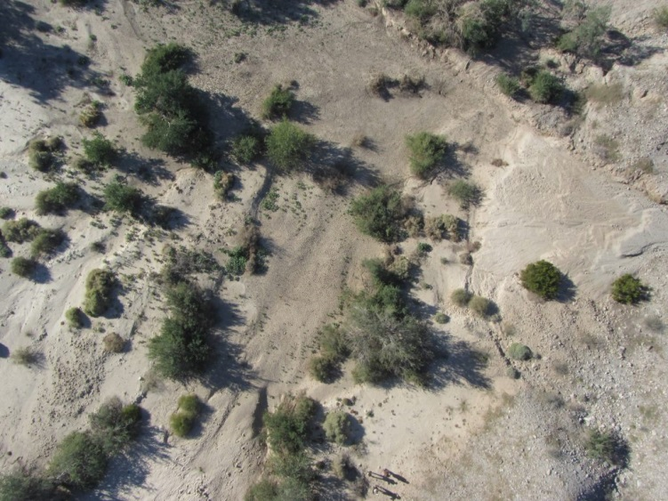
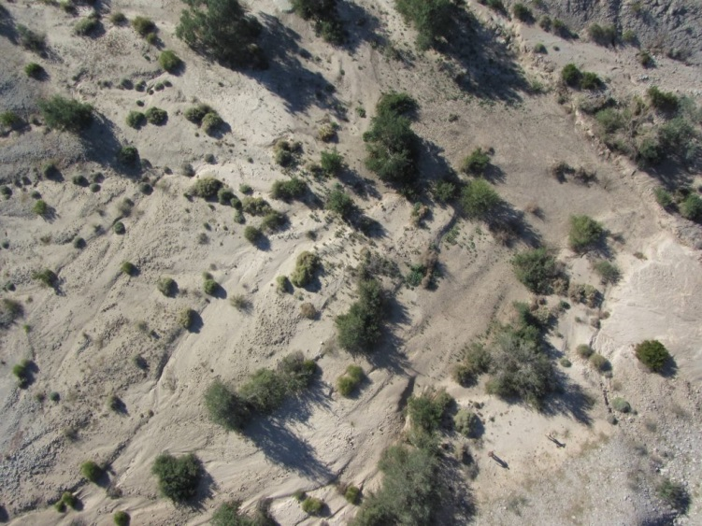
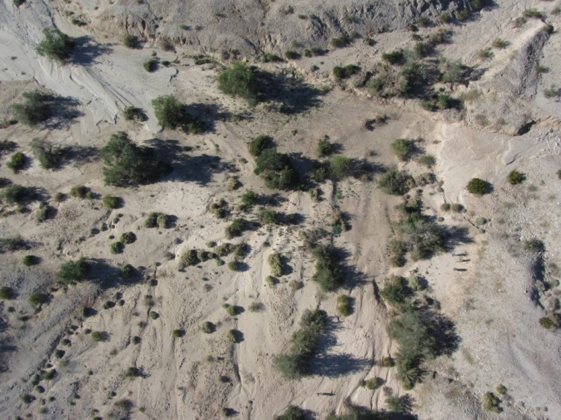
Scale-invariant feature transform (SIFT)
Figure Ed Nissen
Notes:
Each red box shows the same feature in multiple photographs. The SIFT algorithm recognizes these as the same feature.

Slide 21
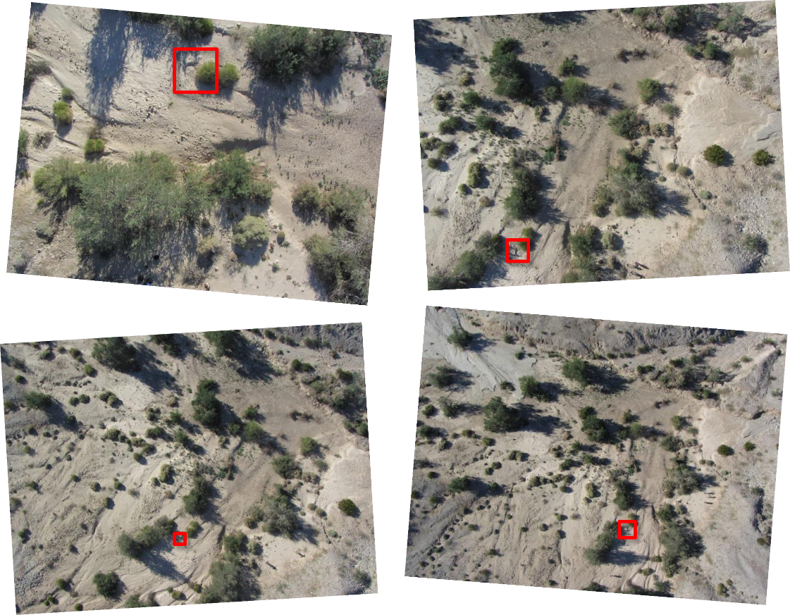
Scale-invariant feature transform (sift)
Finds matching features in multiple photographs
Scale, perspective, and illumination of the feature in the photograph do not affect algorithm
Used as the input for calculating camera locations
Figure Ed Nissen
Notes:
[Read the slide.]
A primary pioneer for the SfM method is: Lowe, D.G., 1999. Object Recognition from Local Scale-invariant Features. International
Conference on Computer Vision, Corfu, Greece, pp. 1150–1157.

Slide 22
Find camera locations
d
Step 2
When we have the matching locations of multiple points on two or more photos, there is usually just one mathematical solution for where the photos were taken.
Therefore, we can calculate individual camera positions (x, y, z), (x’, y’, z’), orientations i, i’, focal lengths f, f’, and relative positions of corresponding features b, h, in a single step known as “bundle adjustment.”
f
(x, y, z)
i
f’
d'
(x’, y’, z’)
i’
h
b
Figure Ed Nissen
Notes:
When we have the matching locations of multiple points on two or more photos, there is usually just one mathematical solution for where the photos were taken. [spacebar] This step, bundle adjustment, results in the locations of the cameras and a sparse point cloud—like the one we saw on the earlier slide, but with significantly fewer points.

Slide 23
Multi-view stereo
d
Step 3
Next, a dense point cloud and 3D surface are determined using the known camera parameters and the sparse point cloud as input.
All pixels in all images are used so the dense model is similar in resolution to the raw photographs (typically 100s–1000s point/m²). This step is called “multi-view stereo matching” (MVS).
f
(x, y, z)
i
f’
d'
(x’, y’, z’)
i’
h
b
Figure Ed Nissen
Notes:
Multi-view stereo is a process that results in the creation of a dense point cloud, like the example on the earlier slide. The MVS algorithm takes the sparse point cloud and camera locations to populate the model with more points. The resultant point cloud may have millions of points.

Slide 24
georectification
d
Step 4
Georectification means converting the point cloud from an internal, arbitrary coordinate system into a geographical coordinate system. This can be achieved in one of two ways:
f
(x, y, z)
i
f’
d'
(x’, y’, z’)
i’
h
b
Figure Ed Nissen
Notes:
Georectification means converting the point cloud from an internal, arbitrary coordinate system into a geographical coordinate system. This step is essential; we want to be able to link the model to where it actually is in space. This results in the ability to measure features in the model, because it will be correctly scaled. [spacebar]

Slide 25
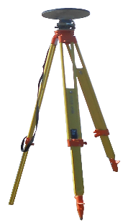
georectification
d
Step 4
Georectification means converting the point cloud from an internal, arbitrary coordinate system into a geographical coordinate system. This can be achieved in one of two ways:
• directly, with knowledge of the camera positions and focal lengths
• indirectly, by incorporating a few ground control points (GCPs) with known coordinates. Typically these would be surveyed using differential GPS.
f
(x, y, z)
i
f’
d'
(x’, y’, z’)
i’
h
b
GPS base station
GCPs surveyed
with roving receiver
Figure Ed Nissen
Notes:
The process of georectification can be achieved in two ways: directly or indirectly. Generally, the indirect process is what scientists use. This way, the model is not only correctly scaled but also correctly located geographically. The number of ground control points varies project to project; however, a minimum of three is needed. It is recommended to use more than 10 per project. Find points that are clearly recognizable or use targets (usually the recommended option).

Slide 26
products
d
Optional Step 5
Generate derivative products:
Digital Surface Model
Orthomosaic for texture mapping
f
(x, y, z)
i
f’
d'
(x’, y’, z’)
i’
h
b
GPS base station
GCPs surveyed
with roving receiver
Figure Ed Nissen
Notes:
The last step in the production of an SfM model is to create the final products. Generally, people use the topography (digital surface model) or the imagery (orthomosaic). The next slides show some examples.

Slide 27
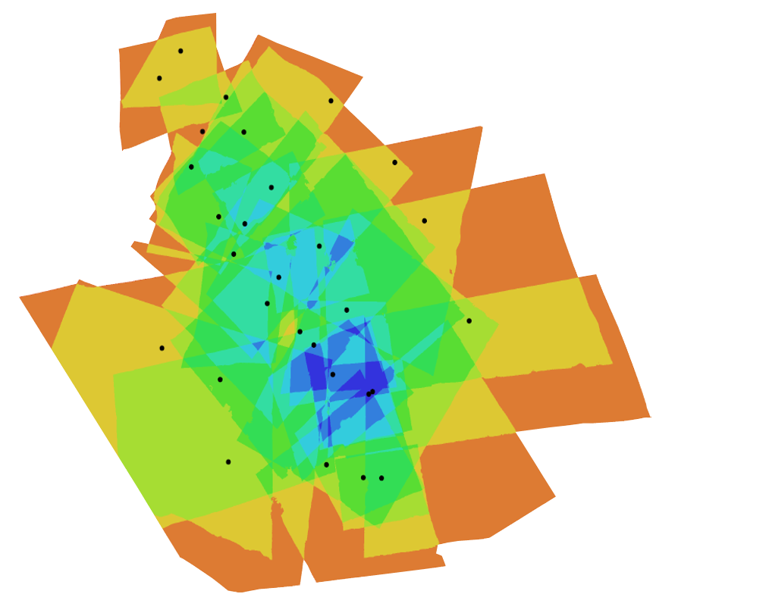
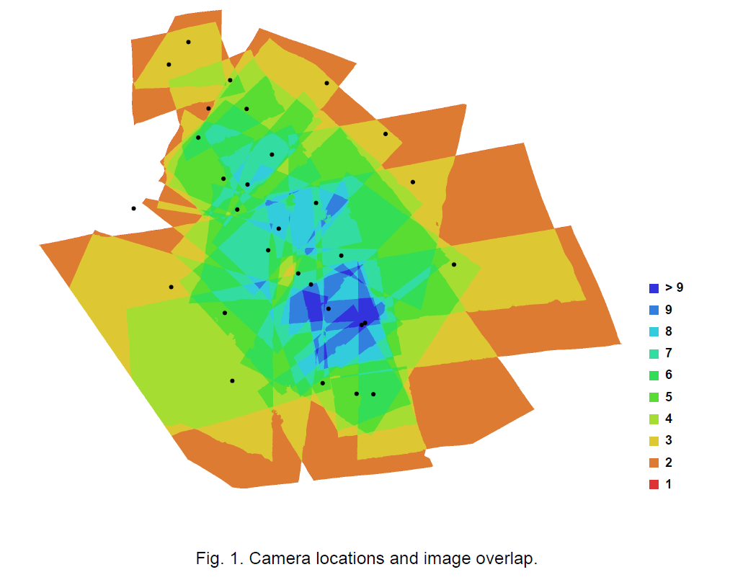
Photo density map
Figure Ed Nissen
Notes:
This photo density map shows the amount of overlap between the photos in a dataset. Each dot is a camera location. You can see the photos are the most dense around areas with lots of camera locations like the center, but that in this model every spot was seen by at least two photographs.

Slide 28
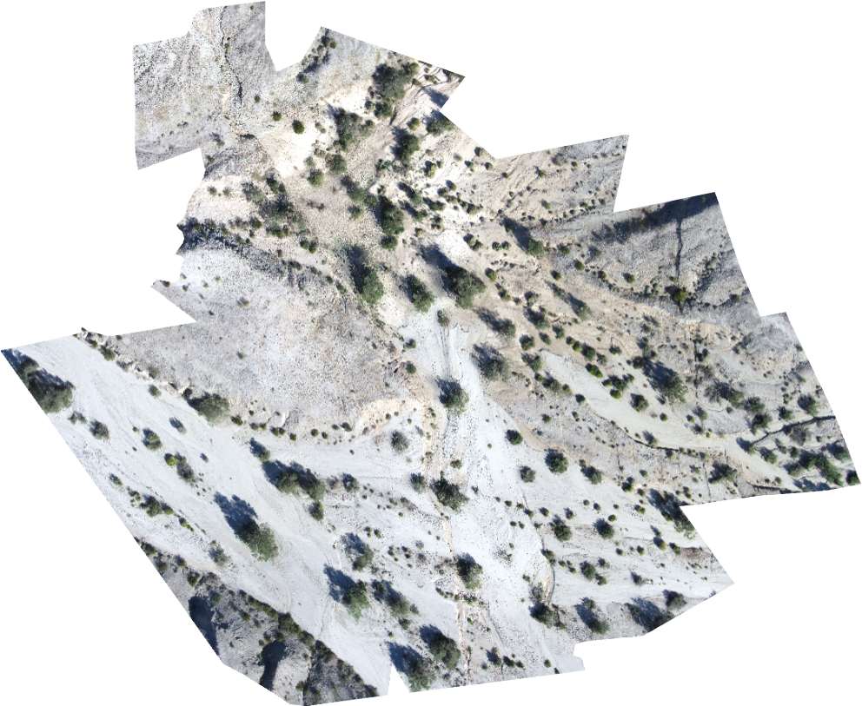
orthomosaic
Figure Ed Nissen
Notes:
The orthomosaic is a high-resolution photograph of the area created by associating color with each point in the model. This can be used to view the features on the surface.

Slide 29
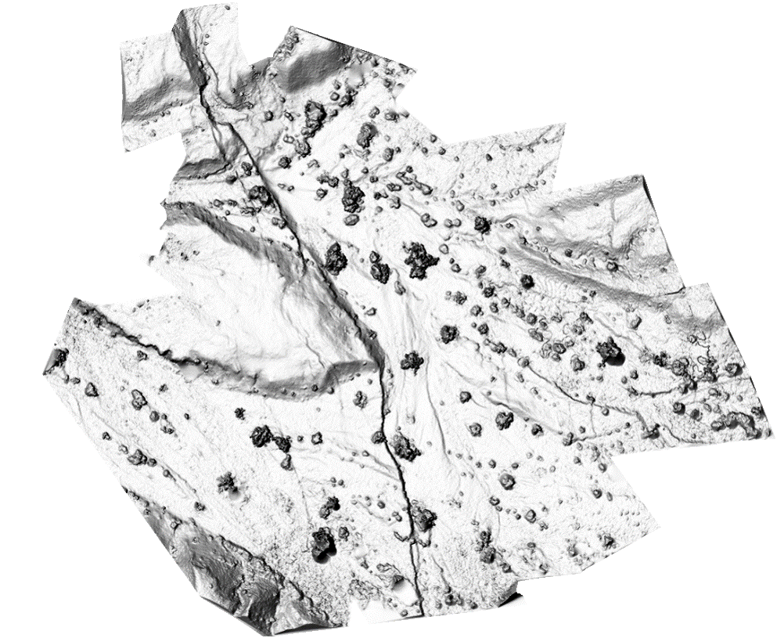
Shaded digital elevation model
Figure Ed Nissen
Notes:
DEM – Digital elevation model. This one has hillshade, so it seems like the sun is shining and it is partially in shadow to show off the features. You can see that different features stand out in the DEM in comparison to the orthomosaic, so they can be used for different research applications. You can use this to measure features.

Slide 30
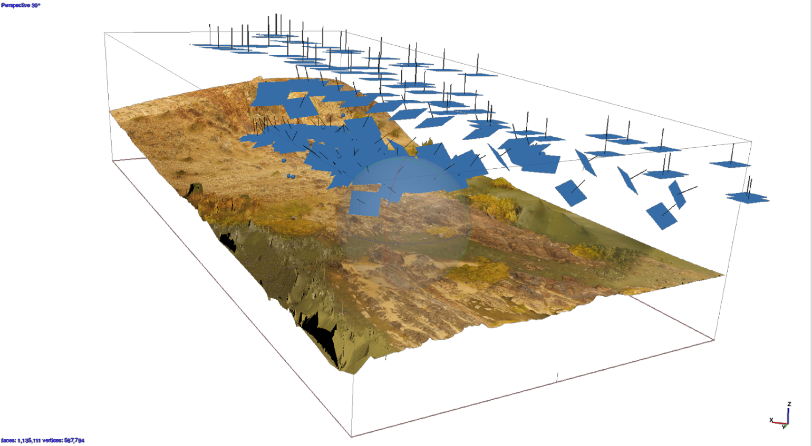
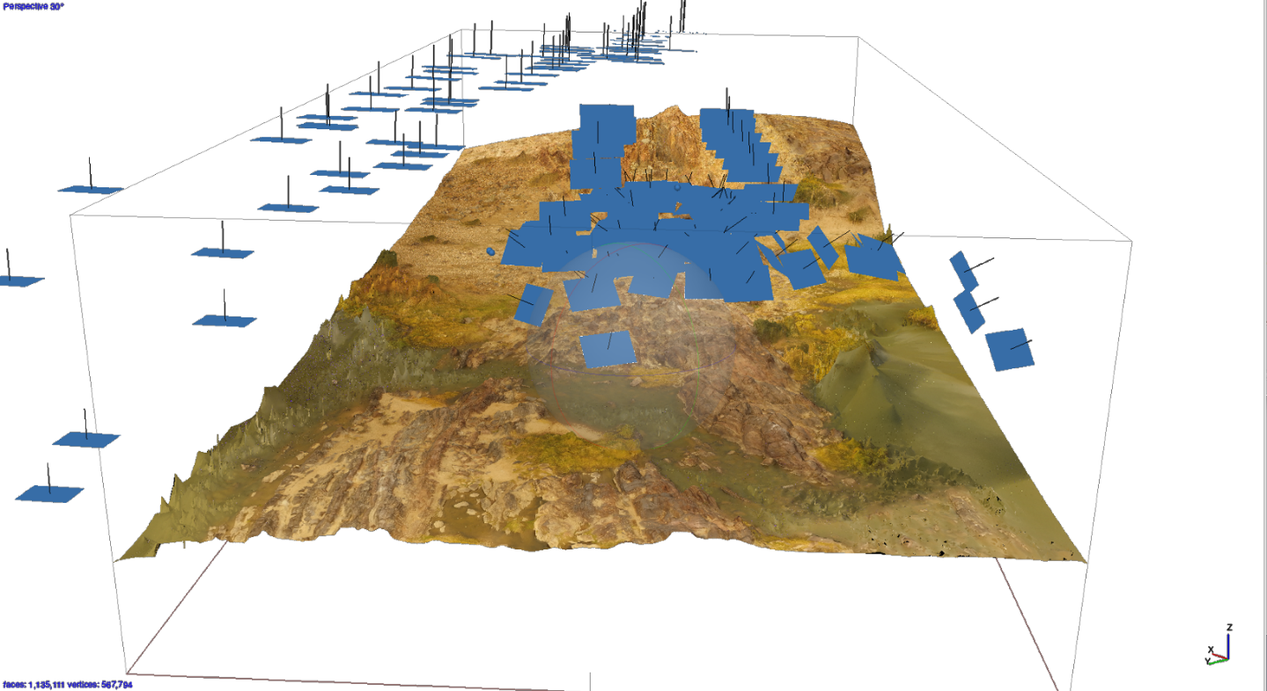
Pofadder shear zone model – photo locations
Figure Jamie Kirkpatrick
Notes:
The blue rectangles show the camera locations for the photos used for the model. The photos line up and show the flight paths taken [spacebar]. As you can see, many flight paths were combined to create the model of the shear zone, not just the one shown in the video.

Slide 31
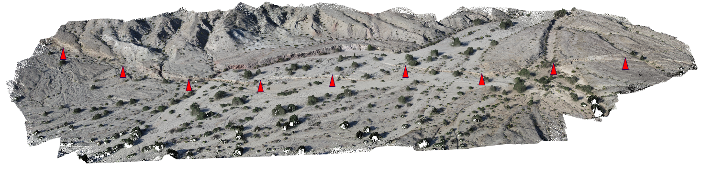
What do you create?
~500 points/m² colored point cloud along a ~1 km section of the 2010 El Mayor-Cucapah earthquake rupture generated from ~500 photographs captured in 2 hours from a helium blimp
Figure Ed Nissen
Notes:
The model above is a three-dimensional point cloud with associated color. This model is of a fault scarp; the red arrows point toward the location of the scarp. You will see a different view of this figure later in the presentation. Most researchers who use SfM use it to make point clouds like these: 3D models of a field area they can revisit and actually measure in the lab instead of the field. Can you think of anything to model using SfM? [Make a list on the board.] Why would SfM be a good method to use for these applications? [add to list on the board.]

Slide 32
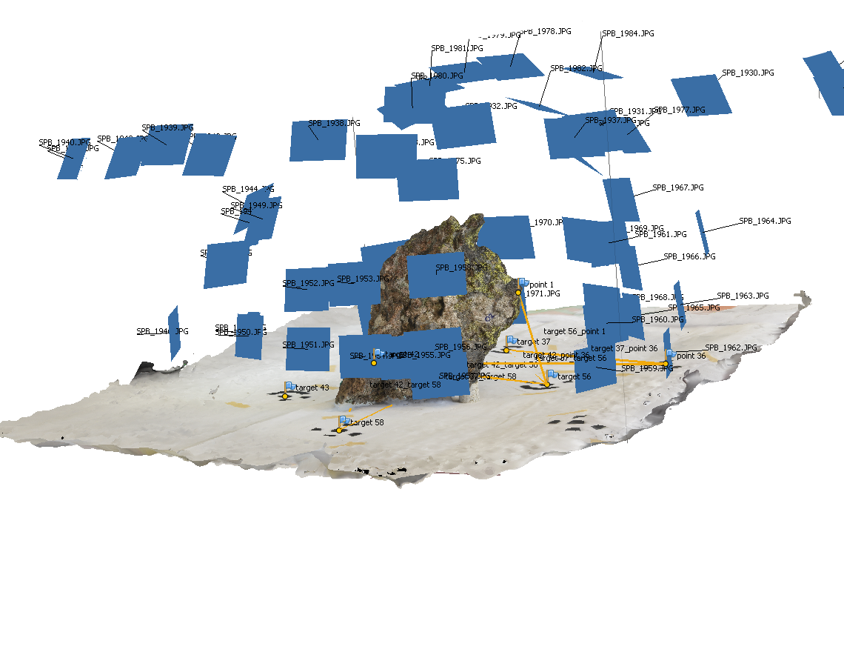
Rock sample model
Figure Sean Bemis
Notes:
The first example of a ground-based SfM model is this basalt sample. Photographs were taken at each of the blue rectangles (indicating the calculated camera location).

Slide 33
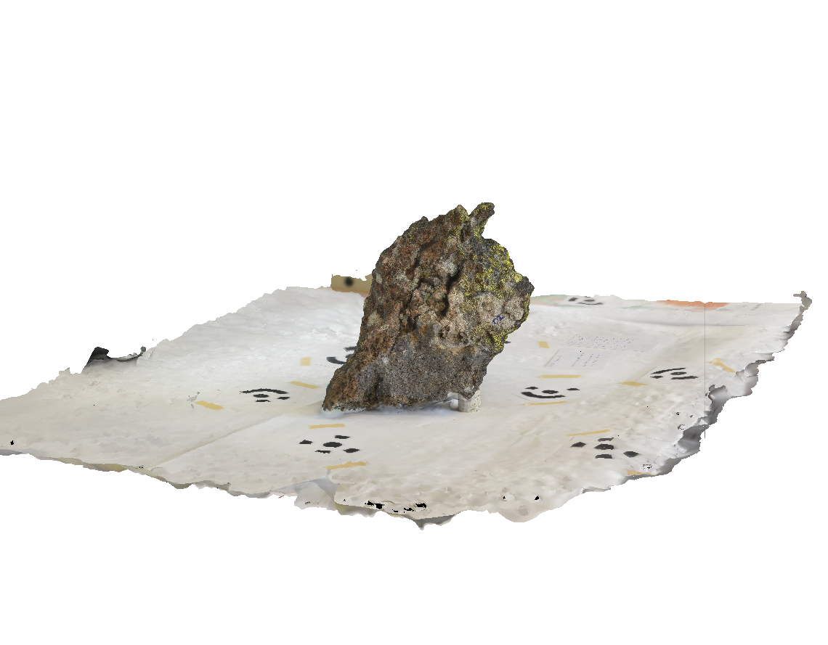
Rock sample model
Figure Sean Bemis
Notes:
When the camera locations are removed, you can see the sample a bit better. The black patterns on the cloth underneath the sample are used to scale the image. This model is used for students; they can look at hand samples in a digital form in addition to the hand sample in the classroom.

